Slide 1
Fundamental
Of
Computer

Slide 2
Meaning of computer
Computer Word Derived from Latin Term “COMPUTE” Which means calculate or Manipulate.
Computer as an electronic devices. It accept the data and instructions from Input devices and Process it in CPU after processing it give out results by Output Device.
In 1822 Charles Babbage developed the analytical engine which resembles modern computers hence Charles Babbage is called as father of computer.

Slide 3
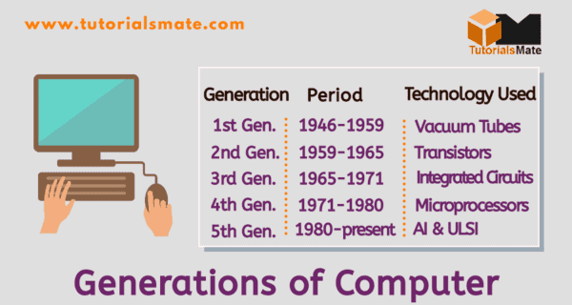
Generations of computer

Slide 4
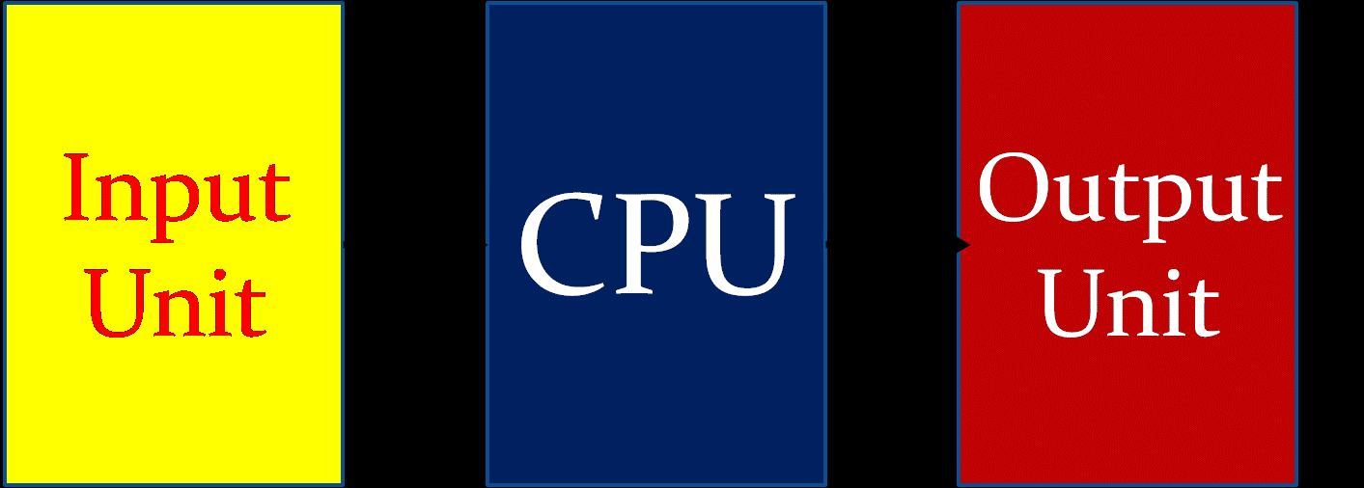
Three types of unit
Input devices or unit
CPU (Central Processing Unit)
Out device or unit

Slide 5
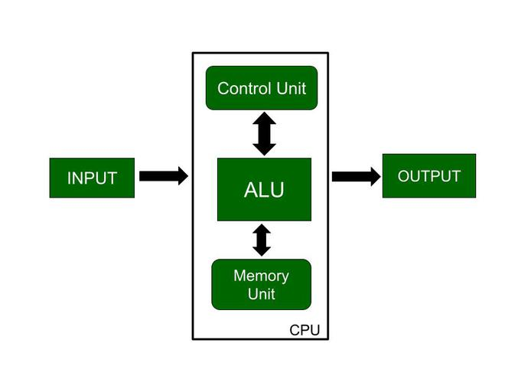
Block Diagram Of A Computer

Slide 6
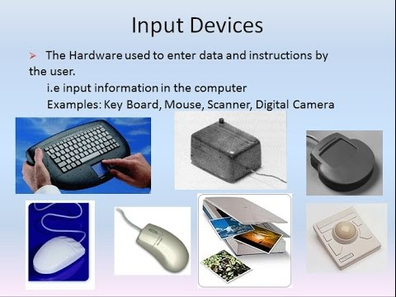

Slide 7
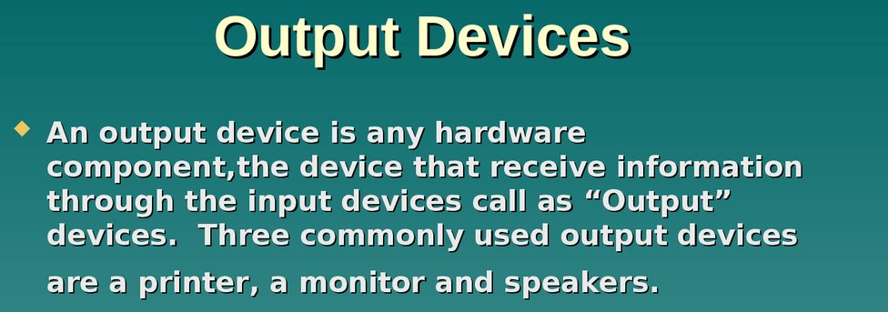
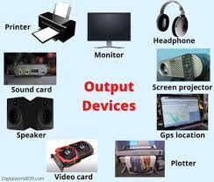

Slide 8
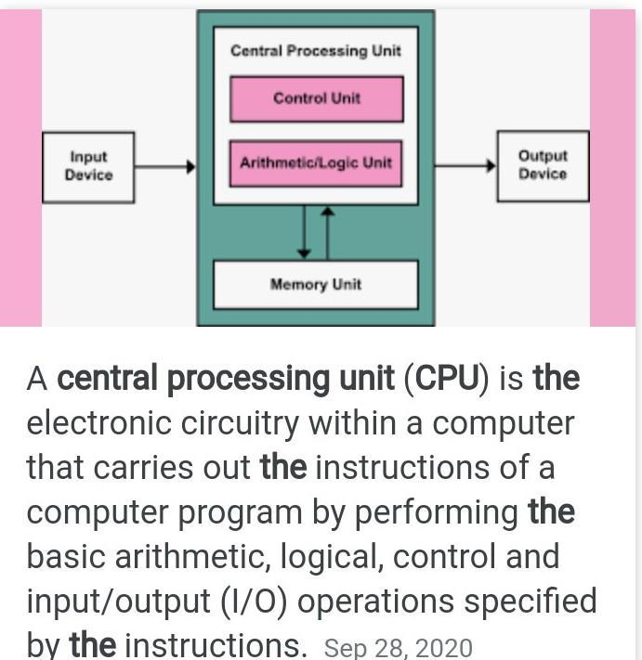

Slide 9
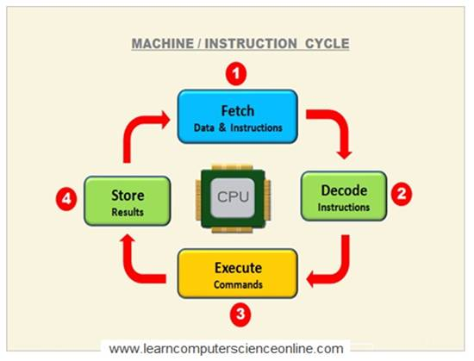

Slide 10
Computer Memory
A memory is just like a human brain. It is used to store data and instructions. Computer memory is the storage space in the computer, where data is to be processed and instructions required for processing are stored.
Memory is primarily of three types − 1) Cache Memory
2) Primary Memory/Main Memory
3) Secondary Memory

Slide 11
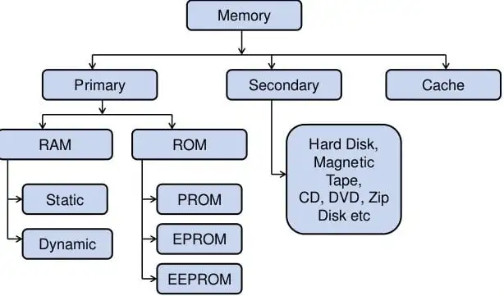

Slide 12
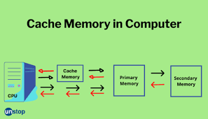
Cache Memory
Cache memory is a very high speed semiconductor memory which can speed up the CPU. It acts as a buffer between the CPU and the main memory. It is used to hold those parts of data and program which are most frequently used by the CPU

Slide 13
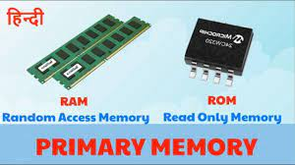
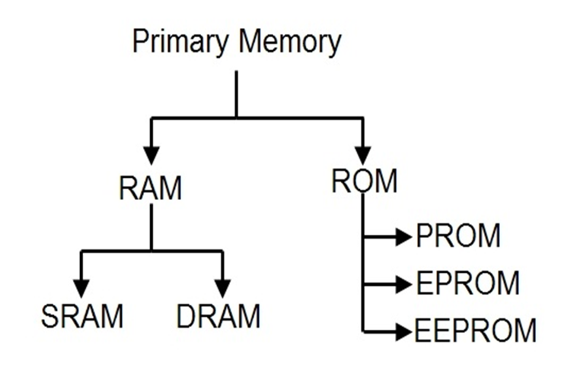
Primary Memory (Main Memory)
Primary memory holds only those data and instructions on which the computer is currently working. It has a limited capacity and data is lost when power is switched off. It is generally made up of semiconductor device.

Slide 14
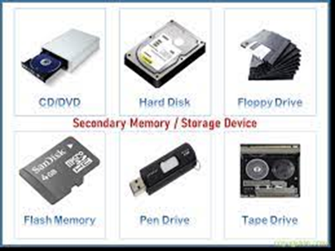
Secondary Memory
This type of memory is also known as external memory . It is slower than the main memory. These are used for storing data/information permanently. CPU directly does not access these memories, instead they are accessed via input-output routines.

Slide 15
Data storage capacity units of measurement
1 Nibble = 4 Bit
8 Bits = 1 Byte
1024 Bytes = 1 Kilobyte
1024 Kilobytes = 1 Megabyte
1024 Megabytes = 1 Gigabyte
1024 Gigabytes = 1 Terabyte
1024 Terabytes = 1 Petabyte
1024 Petabytes = 1 Exabyte

Slide 16
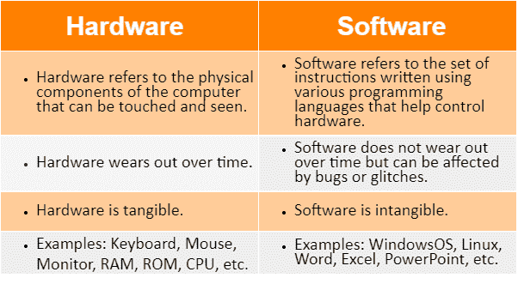

Slide 17
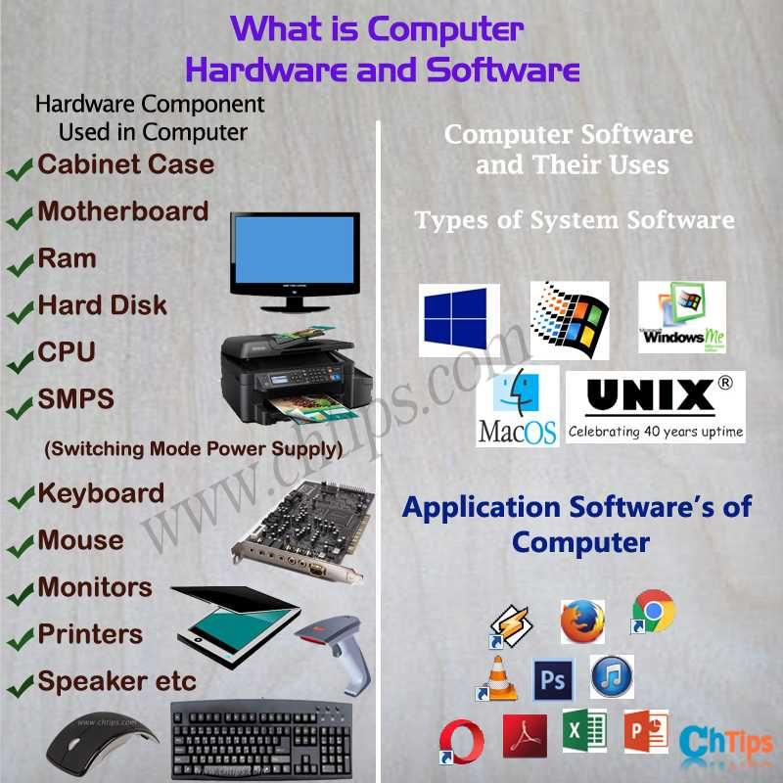

Slide 18
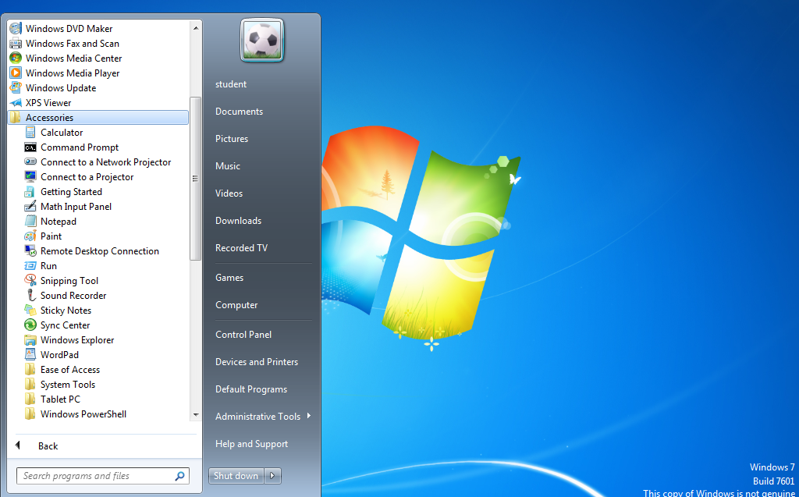
Default Applications Of Windows
Notepad

Slide 19
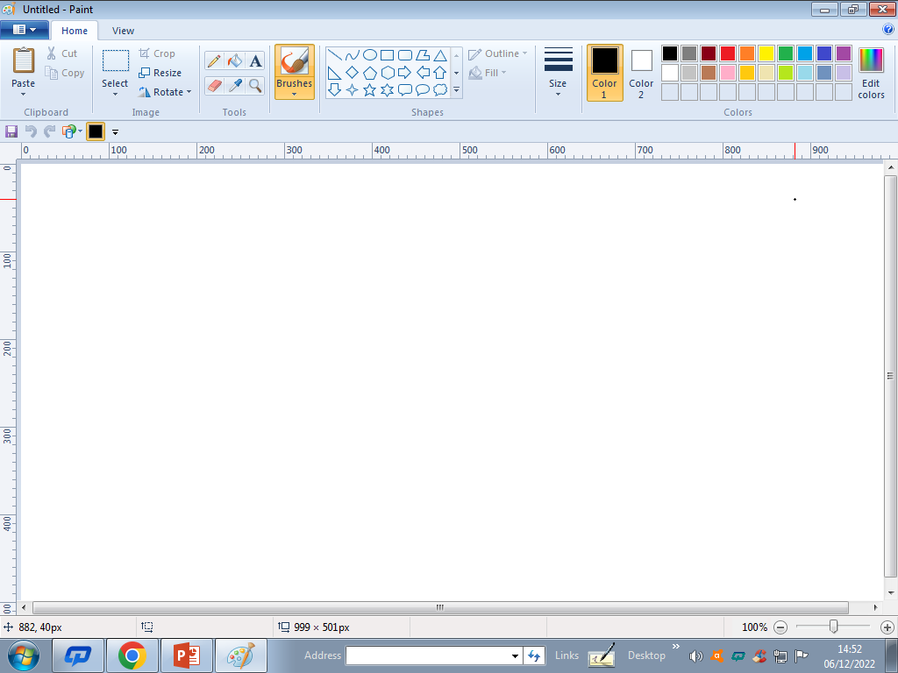
MS Paint

Slide 20
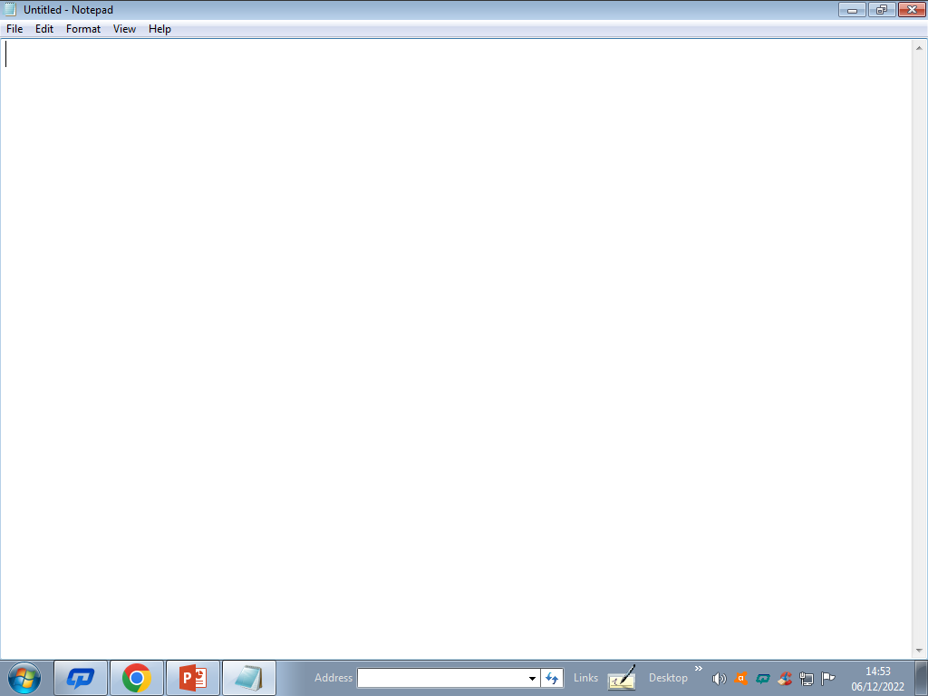
Notepad

Slide 21
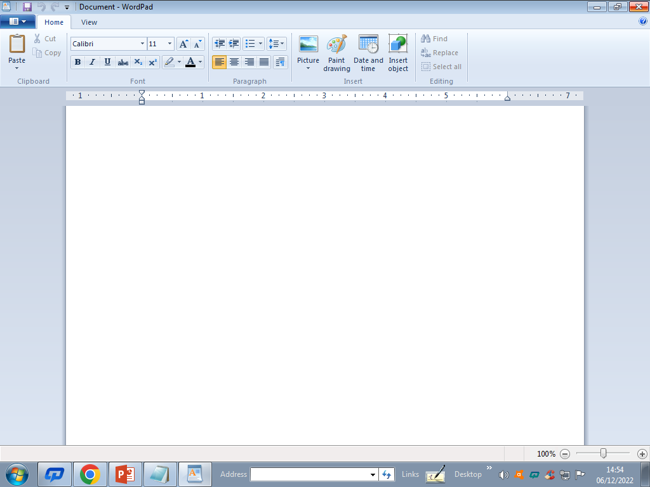
Word pad

Slide 22
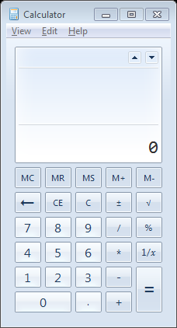
Calculator

Slide 23
Folder Creation
Creating a folder in particular location is super simple and you have more than one way to do it.
Step 1: Right-click a blank spot on your desktop, Document, My computer
Step 2: Move your cursor to New in the menu and pick Folder in the list
Step 3 : Rename folder according to work name

Slide 24
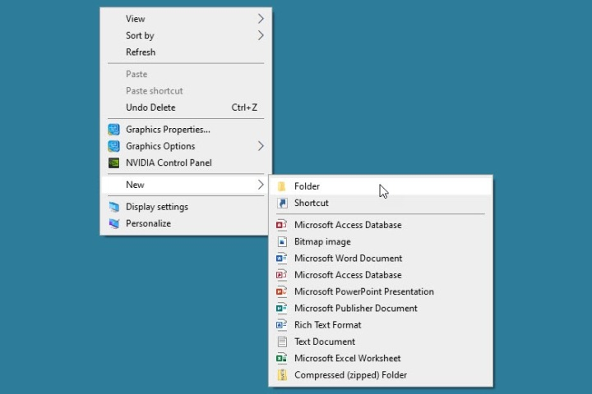
Folder Creation steps

